Slide 1
VENN Diagrams
EQ – How do we sort data using Venn Diagrams?
Year 10 Mathematics

Slide 2
Lesson objective
By the end of this lesson you will be able to;
Constructs and uses venn diagrams to calculate probabilities
C grade and above: Lists outcomes for two and three-step chance experiments using tree diagrams, arrays and Venn diagrams as required, with or without replacement, and calculates the probability of outcomes.
Notes:
Lesson

Slide 3
24
7
30
Topic: Venn Diagrams
Date: 14/06/2018
EQ – How do we sort data using Venn diagrams?
Venn Diagrams are used to compare and contrasts sets of data. A set is a collection of items that have something in common and are written inside curly brackets, { }.
Multiples of 3
Even numbers
These numbers needed to be sorted into multiples of 3 and even numbers
3
5
7
10
13
15
18
24
25
27
30
36
40
50

Slide 4
A VENN DIAGRAM IS USED TO SORT THINGS
Multiples of 3
Even numbers
Multiples of 3 go inside this circle
3
5
7
10
13
15
18
24
25
27
30
36
40
50

Slide 5
A VENN DIAGRAM IS USED TO SORT THINGS
Multiples of 3
Even numbers
Even numbers go inside this circle
3
5
7
10
13
15
18
24
25
27
30
36
40
50

Slide 6
A VENN DIAGRAM IS USED TO SORT THINGS
Multiples of 3
Even numbers
Numbers that are multiples of 3 and even numbers go here because they belong to both circles...
3
5
7
10
13
15
18
24
25
27
30
36
40
50

Slide 7
A VENN DIAGRAM IS USED TO SORT THINGS
Multiples of 3
Even numbers
Numbers that are not multiples of 3 and not even, stay on the outside.
3
5
7
10
13
15
18
24
25
27
30
36
40
50

Slide 8

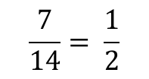
A VENN DIAGRAM IS USED TO SORT THINGS
Multiples of 3
Even numbers
5
27
36
10
13
15
50
24
30
3
7
18
40
25
Numbers that are not multiples of 3 and not even, stay on the outside.
P(multiple of 3) =
$$\frac{7}{14}= \frac{1}{2}$$
P(only even number) =
$$\frac{3}{14}$$

Slide 9
24
7
30
Topic: Venn Diagrams
Date: 14/06/2018
EQ – How do we sort data using Venn Diagrams?
Definitions:
A
B
The intersection is where two sets overlap.
This means A and B.
A
B
If you put two sets together, you get the union.
This means A or B.

Slide 10
24
7
30
Topic: Venn Diagrams
Date: 14/06/2018
EQ – How do we sort data using Venn Diagrams?
Definitions:
A
B
The complement of A is the region that is not A.
This means not A.

Slide 11


Slide 12
Example In a class of 30 students, 19 study physics, 17 study chemistry and 15 study both. Use a Venn diagram to display this information.
Physics
Chemistry
P(P and C) = P(P∩C) =
P(P or C) = P(P∪C) =

Slide 13
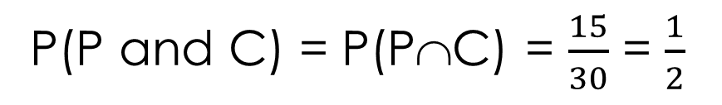
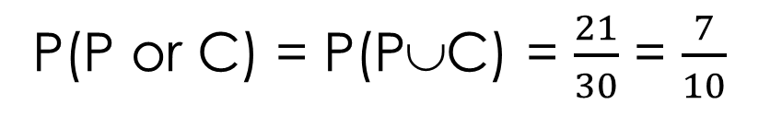
Example In a class of 30 students, 19 study physics, 17 study chemistry and 15 study both. Use a Venn diagram to display this information.
Physics
Chemistry
4
15
2
9
P(P and C) = P(P∩C) = $\frac{15}{30}$ = $\frac{1}{2}$
P(P or C) = P(P∪C) = $\frac{21}{30}$ = $\frac{7}{10}$

Slide 14
Task
Dwyer Year 10 Text, Exercise 8.5, Questions 1-3, p.108
And/Or Problems Puzzle Sheet

